Slide 1
Decision Trees
By- Dr. Amit Rathi, Dept of CSE, JUET, Guna
Ref Book: Aurélien Géron

Slide 2
Decision Trees
Like SVMs, Decision Trees are versatile Machine Learning algorithms that can per‐ form both classification and regression tasks, and even multioutput tasks.
They are powerful algorithms, capable of fitting complex datasets.
Decision Trees are also the fundamental components of Random Forests, which are among the most powerful Machine Learning algorithms available today.

Slide 3
The CART Training Algorithm
The Classification And Regression Trees (CART) algorithm is a supervised machine learning method that builds binary decision trees by recursively splitting data into subsets.
It selects splits that minimize impurity (Gini index/entropy) for classification or sum of squared errors (variance) for regression, typically using pruning to prevent overfitting.

Slide 4
Key Features of the CART
Binary Splitting: CART splits nodes into exactly two branches, unlike algorithms that allow multi-way splits.
Recursive Partitioning: The algorithm starts with all data at the root node and splits it based on the best feature/threshold combo, then repeats this process on the resulting nodes.

Slide 5
Key Features of the CART
Splitting Criteria:
  Classification: Uses Gini impurity, misclassification error, or entropy to measure node homogeneity.
  Regression: Minimizes the sum of squared errors (SSE) or variance in the target variable within each child node.
Handling Data Types: CART can handle both numerical and categorical inputs.
Pruning: After growing the full tree, CART prunes it (removes branches) to improve generalization on unseen data.

Slide 6
Steps in the CART Algorithm
1. Initialize: Start with the entire dataset at the root node.
2. Find Best Split: For each feature, consider all possible threshold values.
Choose the feature and split point that minimizes the total cost (weighted impurity or SSE).
3. Split Data: Divide the node into two child nodes based on the best split found.

Slide 7
Steps in the CART Algorithm
4. Recursive Growth: Repeat steps 2-3 for each child node.
5. Stop Criteria: Stop splitting when a node reaches a minimum number of samples, maximum depth, or the impurity measure is below a threshold.
6. Pruning: Cut back branches to prevent overfitting.

Slide 8
Steps in the CART Algorithm
Step 1: Evaluate Best Split for Each Feature
Check all features and their possible split values.
Compute impurity or error.
Identify the split that gives the maximum reduction in impurity or error.
Step 2: Select the Optimal Split
Compare impurity decrease for all features.
Choose the feature and threshold pair with the best score.
This becomes the splitting rule for the current node.

Slide 9
Steps in the CART Algorithm
Step 3: Create Binary Child Nodes
Split the dataset into Left Node (values less than or equal to threshold) and Right Node (values greater than or equal to threshold).
Assign corresponding samples to each child node.
Step 4: Apply Recursive Splitting
Repeat the same process for each child node.
Continue until a stopping condition is met.

Slide 10
CART for Classification
CART is used for classification tasks when the output variable is categorical.
How it Works
Recursively splits the dataset to increase class purity at each step.
Uses Gini Impurity to select the best feature and threshold for splitting.
Continues splitting until a stopping rule is met such as maximum tree depth or minimum required samples.
CART chooses splits that produce the purest possible child nodes.

Slide 11
CART for Regression
CART is used for regression tasks where the output variable is numerical.
How it Works
Splits the data to minimize residual error between actual and predicted values.
Uses Mean Squared Error (MSE) or Residual Sum of Squares (RSS) as the splitting criterion.
Each leaf node stores the mean of the target values within that node, which becomes the prediction for new samples.
This helps CART create a tree that provides the lowest possible prediction error.

Slide 12
Splitting Criteria in CART
CART uses different metrics to choose the best splitting rule depending on whether the problem is a classification or regression task.
The goal is to find the split that produces the purest child nodes (for classification) or minimum prediction error (for regression).

Slide 13
Splitting Criteria in CART
Splitting Criteria for Classification
CART uses Gini Impurity to measure how mixed the classes are in a node.
Gini Impurity indicates how likely a randomly chosen sample from the node would be incorrectly classified if it were assigned labels according to class distribution.
It calculates the likelihood of misclassification, ranging from 0 (perfectly pure) to 0.5 or higher (high impurity/mix).

Slide 14
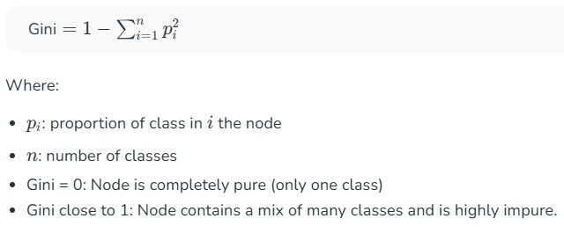
Splitting Criteria in CART
Splitting Criteria for Classification

Slide 15
Splitting Criteria in CART
Splitting Criteria for Regression
For regression problems, CART uses Residual Sum of Squares (RSS) or Mean Squared Error (MSE) to find the best split.
Residual Sum of Squares (RSS): RSS measures the total squared difference between actual output values and predicted values.

Slide 16
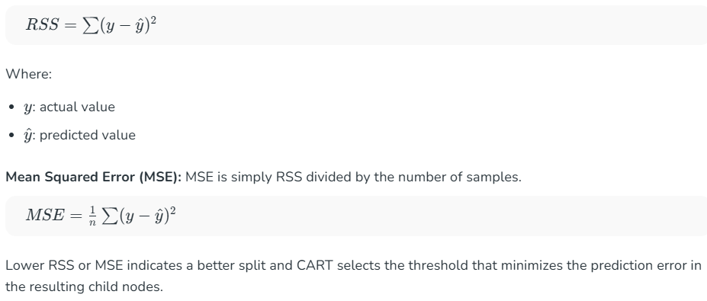
Splitting Criteria in CART
Splitting Criteria for Regression

Slide 17
Pruning in CART
Pruning is used to prevent overfitting by trimming branches of the decision tree that add little or no improvement to model accuracy.
It simplifies the tree, improves generalization and reduces model complexity.

Slide 18
Pruning in CART
Types of Pruning in CART
Cost Complexity Pruning: Removes branches by comparing the trade off between tree accuracy and tree size, keeping only those nodes that significantly improve performance.
Reduced Error Pruning: Eliminates nodes that do not improve the model’s accuracy on a validation dataset, ensuring only beneficial splits remain.

Slide 19
Pruning in CART
Common Stopping or Pruning Criteria Used in CART
Maximum tree depth reached: The tree stops growing after a predefined maximum depth.
Minimum samples required to split a node: Splitting stops when a node has fewer samples than the minimum required.
No further improvement in impurity: If a split does not reduce impurity or error, CART stops splitting.
Node becomes pure: When all samples belong to one class, no further split is needed.

Slide 20
Hyperparameters in CART
CART provides several hyperparameters to control the tree structure, prevent overfitting and improve model performance.
Important hyperparameters include:
max_depth: Controls the maximum depth of the tree, preventing it from growing too deep and overfitting the data.
min_samples_split: Specifies the minimum number of samples required to split an internal node; higher values make the tree more conservative.

Slide 21
Hyperparameters in CART
min_samples_leaf: Determines the minimum number of samples allowed in a leaf node, helping avoid very small or unstable leaves.
max_features: Defines the number of features to consider while looking for the best split; useful for reducing computation and variance.
criterion: Specifies the function used to evaluate the split gini or entropy for classification and MSE for regression.

Slide 22
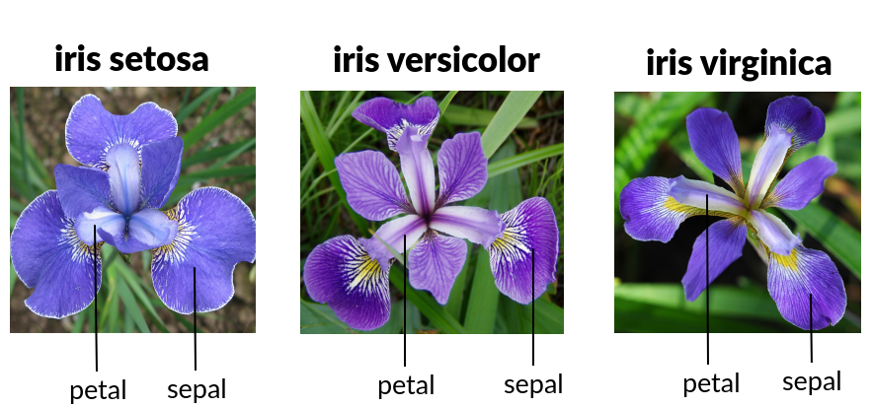
DT of iris Dataset by CART

Slide 23
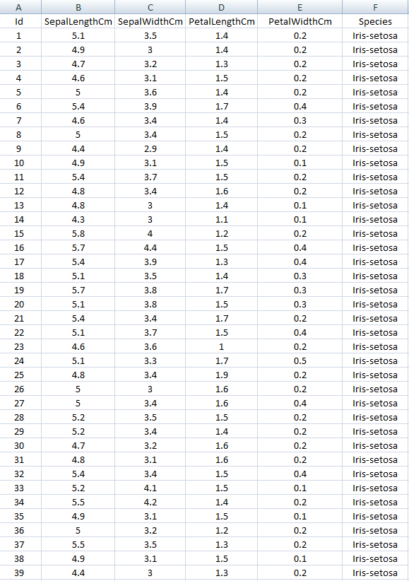
DT of iris Dataset by CART

Slide 24
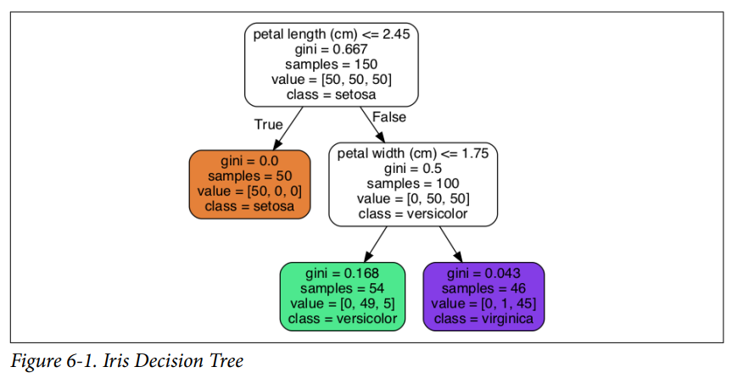
DT of iris Dataset by CART

Slide 25
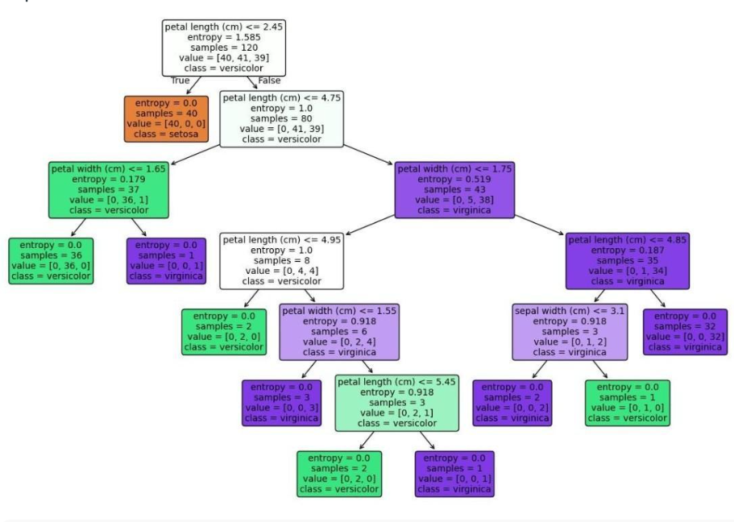
DT of iris Dataset by CART

Slide 26
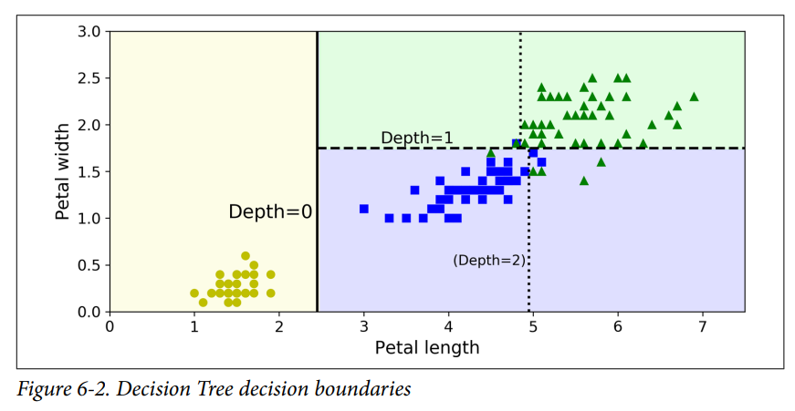
Decision Tree’s decision boundaries

Slide 27
Estimating Class Probabilities
A Decision Tree can also estimate the probability that an instance belongs to a particular class k.
First, it traverses the tree to find the leaf node for this instance, and then it returns the ratio of training instances of class k in this node.
For example, suppose you have found a flower whose petals are 5 cm long and 1.5 cm wide.

Slide 28
Estimating Class Probabilities
The corresponding leaf node is the depth-2 left node, so the Decision Tree should output the following probabilities: 0% for Iris setosa (0/54), 90.7% for Iris versicolor (49/54), and 9.3% for Iris virginica (5/54).
And if you ask it to predict the class, it should output Iris versicolor (class 1) because it has the highest probability.

Slide 29
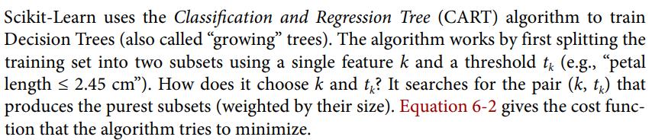
The CART Training Algorithm (Aurélien Géron)

Slide 30
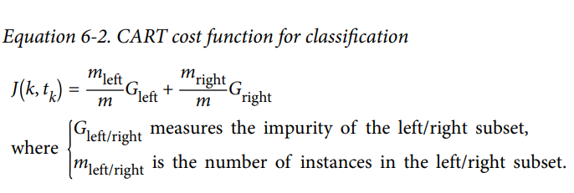
The CART Training Algorithm (Aurélien Géron)

Slide 31
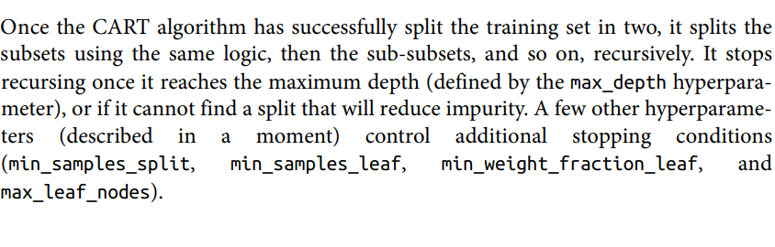
The CART Training Algorithm (Aurélien Géron)

Slide 32
The CART Training Algorithm (Aurélien Géron)
The CART algorithm is a greedy algorithm: it greedily searches for an optimum split at the top level, then repeats the process at each subsequent level.
It does not check whether or not the split will lead to the lowest possible impurity several levels down.

Slide 33
The CART Training Algorithm (Aurélien Géron)
A greedy algorithm often produces a solution that’s reasonably good but not guaranteed to be optimal.
Unfortunately, finding the optimal tree is known to be an NP Complete problem.
It requires O(exp(m)) time, making the problem intractable even for small training sets.
This is why we must settle for a “reasonably good” solution.

Slide 34
Computational Complexity
Making predictions requires traversing the Decision Tree from the root to a leaf.
Decision Trees generally are approximately balanced, so traversing the Decision Tree requires going through roughly O(log₂(m)) nodes.
Since each node only requires checking the value of one feature, the overall prediction complexity is O(log₂(m)), independent of the number of features.
So, predictions are very fast, even when dealing with large training sets.

Slide 35
Computational Complexity
The training algorithm compares all features (or less if max_features is set) on all samples at each node.
Comparing all features on all samples at each node results in a training complexity of O(n × m log₂ (m)).

Slide 36
Gini Impurity or Entropy?
By default, the Gini impurity measure is used, but we can select the entropy impurity measure.
The concept of entropy originated in thermodynamics as a measure of molecular disorder: entropy approaches zero when molecules are still and well ordered.

Slide 37
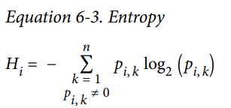
Gini Impurity or Entropy?
In Machine Learning, entropy is frequently used as an impurity measure: a set’s entropy is zero when it contains instances of only one class.
Equation 6-3 shows the definition of the entropy of the i-th node.
For example, the depth-2 left node in Figure 6-1 has an entropy equal to –(49/54) log₂ (49/54) – (5/54) log₂ (5/54) ≈ 0.445.

Slide 38
Gini Impurity or Entropy?
So, should you use Gini impurity or entropy?
The truth is, most of the time it does not make a big difference: they lead to similar trees.
Gini impurity is slightly faster to compute, so it is a good default.
However, when they differ, Gini impurity tends to isolate the most frequent class in its own branch of the tree, while entropy tends to produce slightly more balanced trees.

Slide 39
Regularization Hyperparameters
Decision Trees make very few assumptions about the training data.
If left unconstrained, the tree structure will adapt itself to the training data, fitting it very closely—indeed, most likely overfitting it.

Slide 40
Regularization Hyperparameters
Such a model is often called a nonparametric model, not because it does not have any parameters (it often has a lot) but because the number of parameters is not determined prior to training, so the model structure is free to stick closely to the data.

Slide 41
Regularization Hyperparameters
In contrast, a parametric model, such as a linear model, has a pre‐ determined number of parameters, so its degree of freedom is limited, reducing the risk of overfitting (but increasing the risk of underfitting).

Slide 42
Regularization Hyperparameters
To avoid overfitting the training data, you need to restrict the Decision Tree’s freedom during training.
This is called regularization.
The regularization hyperparameters depend on the algorithm used, but generally you can at least restrict the maximum depth of the Decision Tree.

Slide 43
Regularization Hyperparameters
The DecisionTreeClassifier class has a few other parameters that similarly restrict the shape of the Decision Tree:
  min_samples_split (the minimum number of samples a node must have before it can be split),
  min_samples_leaf (the minimum number of samples a leaf node must have),
  min_weight_fraction_leaf (same as min_samples_leaf but expressed as a fraction of the total number of weighted instances),

Slide 44
Regularization Hyperparameters
  max_leaf_nodes (the maximum number of leaf nodes), and
  max_features (the maximum number of features that are evaluated for splitting at each node).
  Increasing min_*hyperparameters or reducing max_*hyperparameters will regularize the model.

Slide 45
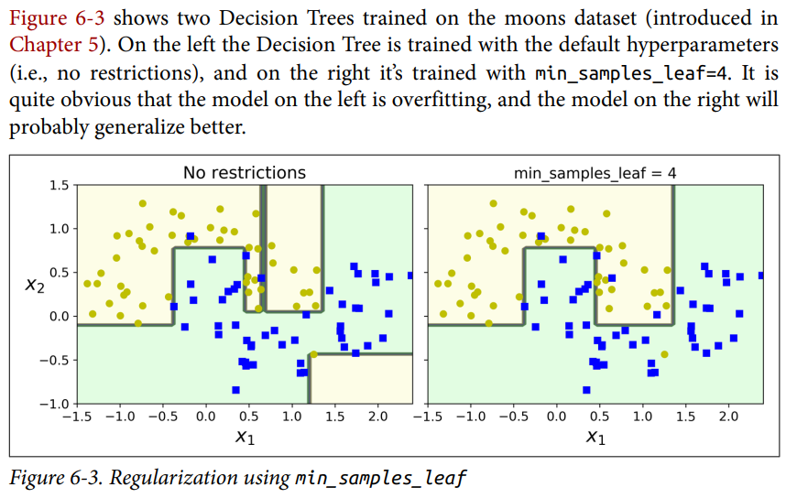
Regularization Hyperparameters

Slide 46
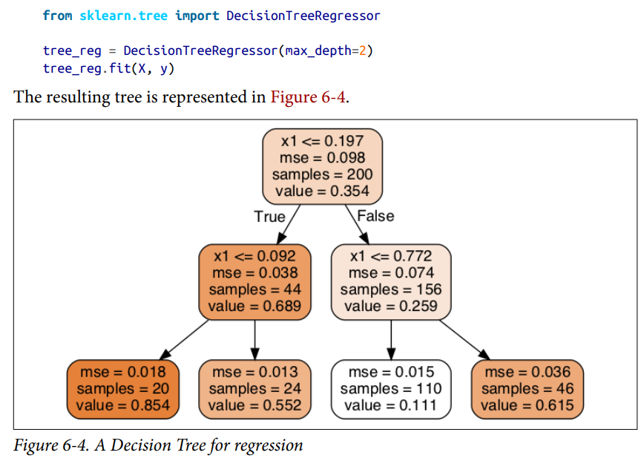
Regression using Decision Trees
Decision Trees are also capable of performing regression tasks.

Slide 47
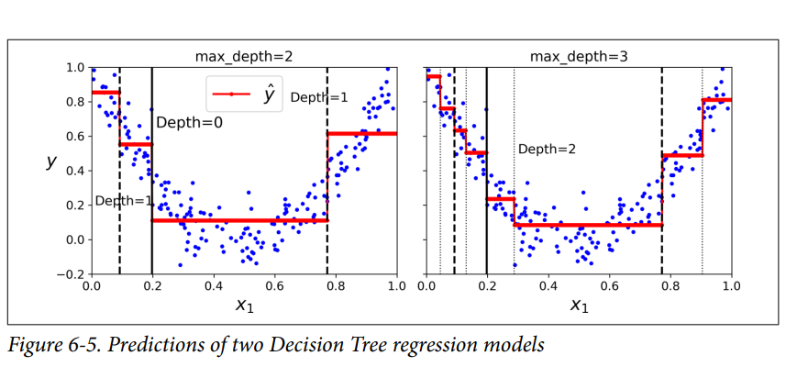
Regression using Decision Trees

Slide 48
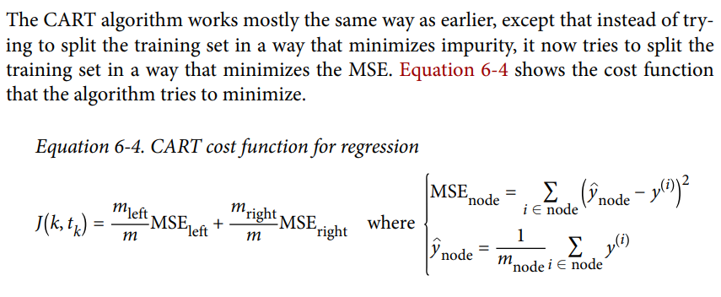
Regression using Decision Trees

Slide 49
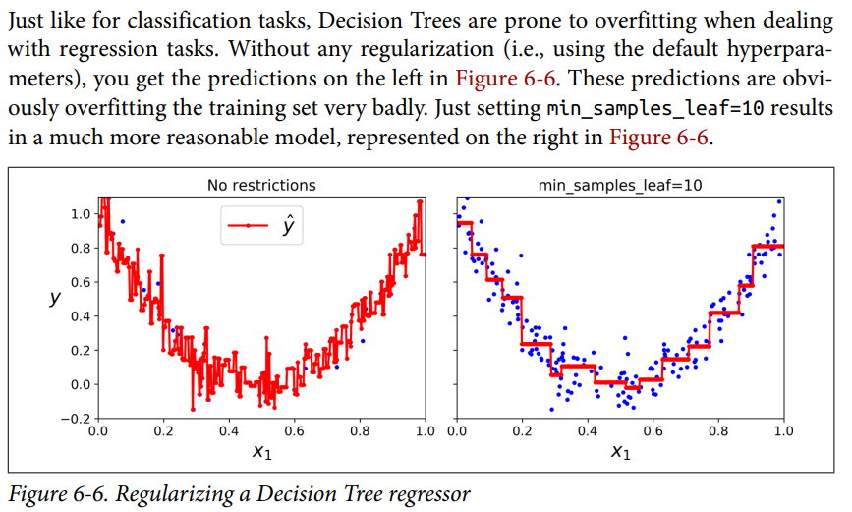
Regression using Decision Trees

Slide 50
Instability in Decision Trees
Decision Trees love orthogonal decision boundaries (all splits are perpendicular to an axis), which makes them sensitive to training set rotation.
For example, Figure 6-7 shows a simple linearly separable dataset: on the left, a Decision Tree can split it easily, while on the right, after the dataset is rotated by 45°, the decision boundary looks unnecessarily convoluted.
Although both Decision Trees fit the training set perfectly, it is very likely that the model on the right will not generalize well.
One way to limit this problem is to use Principal Component Analysis, which often results in a better orientation of the training data.

Slide 51
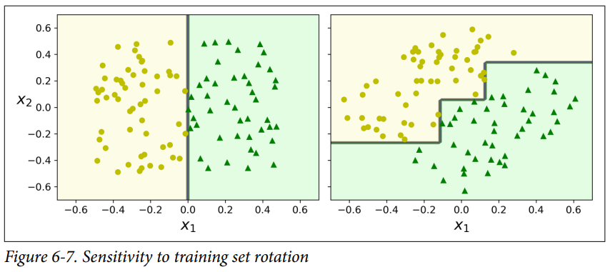
Instability in Decision Trees

Slide 52
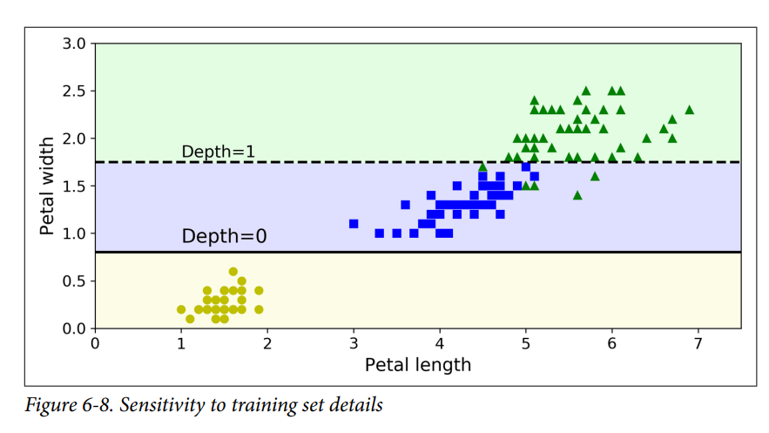
Instability in Decision Trees

